Slide 1


Restaurant Recommendations System
Recommendation systems in the restaurant industry leverage machine learning to provide personalized dining suggestions tailored to individual user preferences and behaviors. By analyzing customer data, these systems can offer relevant and rewarding dining experiences.

Slide 2

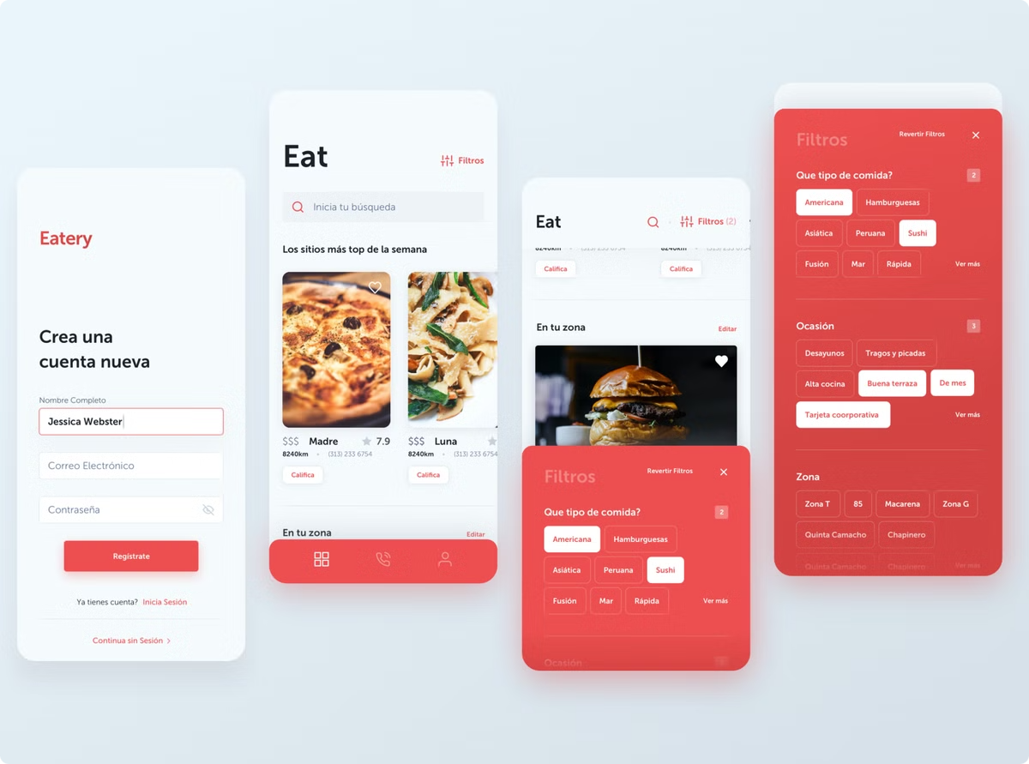
Introduction to Recommendation Systems
Personalization
Discovery
Recommendation systems use data to understand user preferences and provide customized suggestions.
These systems help users discover new restaurants they may not have otherwise considered.
Relevance
Recommendations are based on factors like cuisine, location, reviews, and past behavior.

Slide 3

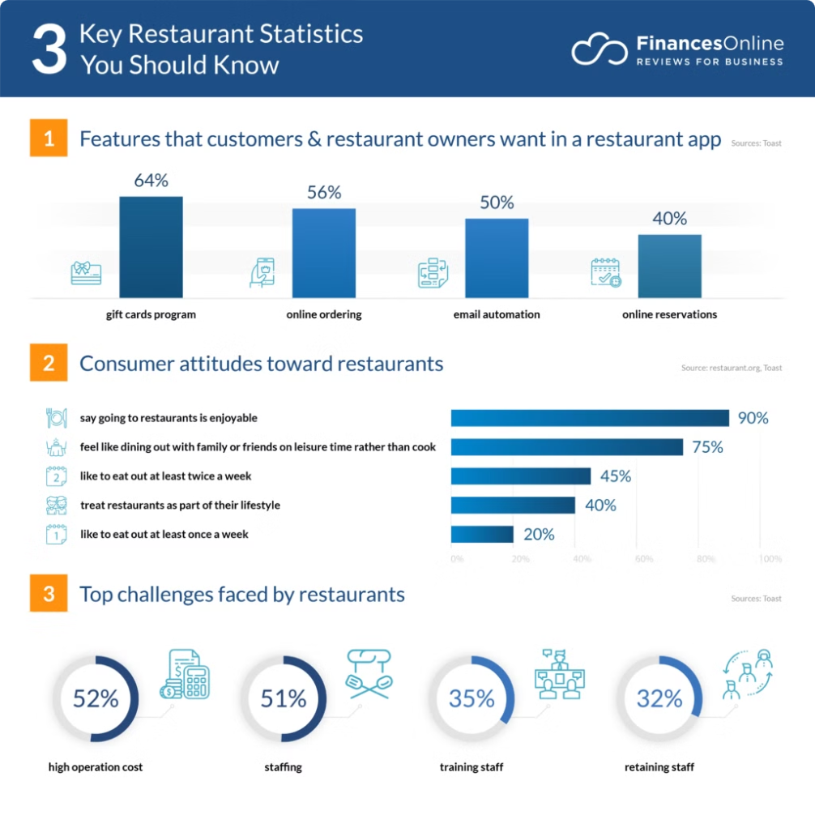
Data Collection and Preprocessing
1
User Data
Collect information on user preferences, past orders, and ratings.
2
Restaurant Data
Gather details on menus, cuisine, location, and reviews.
3
Data Cleaning
Preprocess and normalize the data to prepare for model training.

Slide 4
Feature Engineering
User Features
Restaurant Features
Context Features
Factors like age, location and past orders.
Attributes such as price range, ratings, and amenities.
Considerations like time of day, weather, and special occasions.

Slide 5

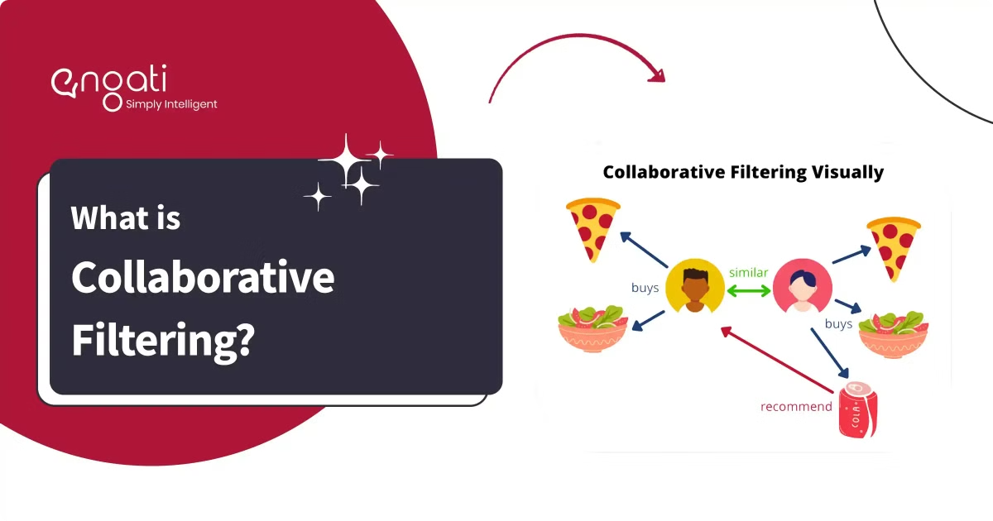
Collaborative Filtering Techniques
1
User-Item Matrix
2
Neighborhood-based
Build a matrix of user preferences and item (restaurant) ratings.
Identify similar users or restaurants based on their preferences.
3
Model-based
Use machine learning models to predict user-item preferences.

Slide 6

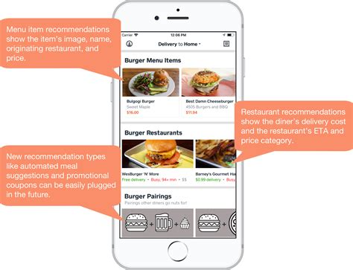
Content-Based Filtering Approaches
1
User Profiles
Construct detailed user profiles based on their preferences and past actions.
2
Item Descriptions
Analyze restaurant attributes and metadata to find the best matches.
3
Recommendation Engine
Match user profiles to restaurant descriptions to generate personalized suggestions.

Slide 7





Hybrid Recommendation Models
Collaborative Filtering
Leverages user-item interactions and similarities.
Content-Based Filtering
Analyzes item attributes and user preferences.
Demographic Filtering
Considers user characteristics and demographics.

Slide 8

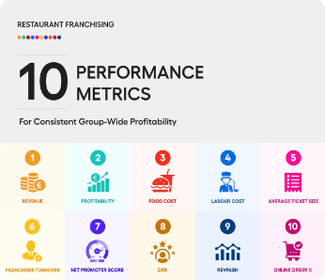
Evaluation Metrics and Benchmarking
Precision
Measure of how many recommended items are relevant.
Recall
Measure of how many relevant items are recommended.
F1-Score
Harmonic mean of precision and recall.
Normalized Discounted Cumulative Gain (NDCG)
Measures the ranking quality of recommendations.

Slide 9





Ethical Considerations in Recommendation Systems
Transparency
Fairness
Privacy
Explain how recommendations are generated to build user trust.
Ensure the system is unbiased and does not discriminate.
Protect user data and provide opt-out options.

Slide 10


Implementation Challenges and Best Practices
Scalability
Cold Start
Handle large datasets and real-time updates efficiently.
Overcome the challenge of making recommendations for new users and items.
Continuous Improvement
Regularly update the system to incorporate user feedback and new data.

